Slide 1
Concepts of Biology Biol 111 Minot State University
Lecture, MWF 12:00-12:50 pm
Cyril Moore Science Center, Room 16
Lab, Tuesdays/Thursdays
Swain Hall, Room 304

Slide 2
Lecture 30 April 20, 2018
Announcements—
Exam 4 not marked yet. Will get them back in lab next week. We will go over them next Friday after they are returned.
Next week’s lab---an evolution board game! You choose your traits!

Slide 3
Where were we?...
Solving the structure of DNA---What does it look like, and how does it work?
Be sure to study the building blocks---nucleotides
Sketch a basic nucleotide—what are the 3 components?
What are the 4 bases? Which are purines? Which are pyrimidines?
What did Erwin Chargaff discover? What did it point to?
Describe the contributions of Rosalind Franklin

Slide 4
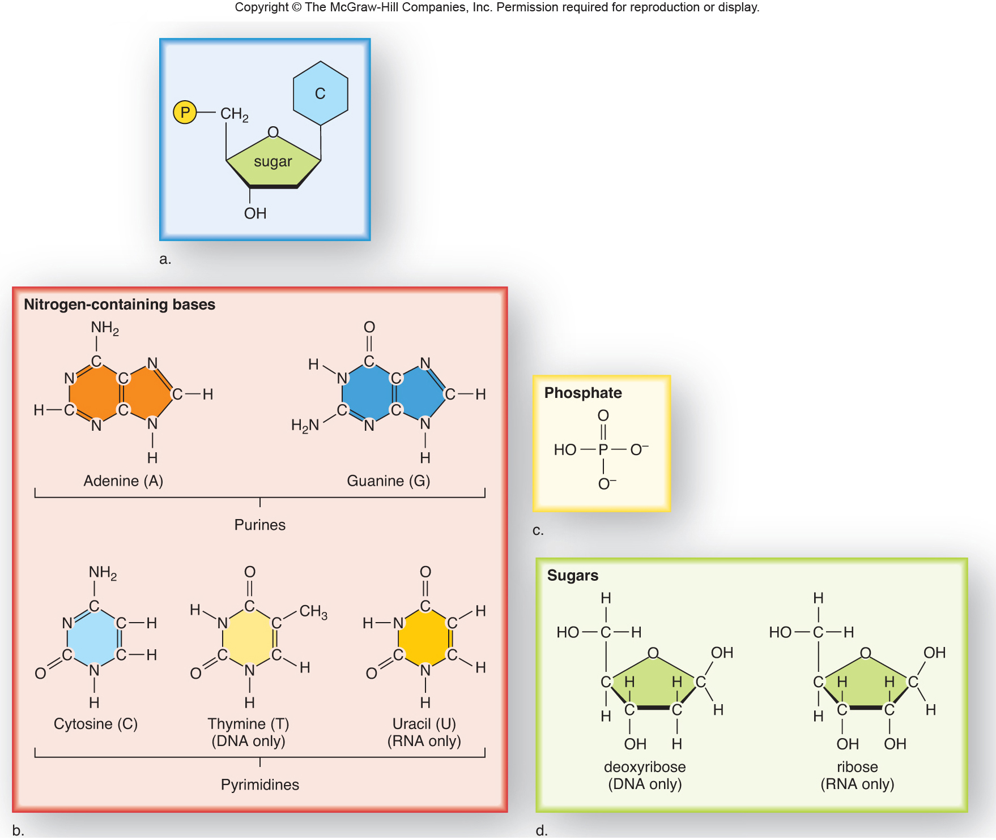
Fig. 11.2

Slide 5
Compare %A to %T and %C to %G for every organism.
Organism | %A | %G | %C | %T | A/T | G/C | %GC | %AT
φX174 | 24 | 23.3 | 21.5 | 31.2 | 0.77 | 1.08 | 44.8 | 55.2
Maize | 26.8 | 22.8 | 23.2 | 27.2 | 0.99 | 0.98 | 46.1 | 54
Octopus | 33.2 | 17.6 | 17.6 | 31.6 | 1.05 | 1 | 35.2 | 64.8
Chicken | 28 | 22 | 21.6 | 28.4 | 0.99 | 1.02 | 43.7 | 56.4
Rat | 28.6 | 21.4 | 20.5 | 28.4 | 1.01 | 1 | 42.9 | 57
Human | 29.3 | 20.7 | 20 | 30 | 0.98 | 1.04 | 40.7 | 59.3
Grasshopper | 29.3 | 20.5 | 20.7 | 29.3 | 1 | 0.99 | 41.2 | 58.6
Sea Urchin | 32.8 | 17.7 | 17.3 | 32.1 | 1.02 | 1.02 | 35 | 64.9
Wheat | 27.3 | 22.7 | 22.8 | 27.1 | 1.01 | 1 | 45.5 | 54.4
Yeast | 31.3 | 18.7 | 17.1 | 32.9 | 0.95 | 1.09 | 35.8 | 64.4
E. coli | 24.7 | 26 | 25.7 | 23.6 | 1.05 | 1.01 | 51.7 | 48.3

Slide 6
The key points
DNA is made of 2 strands of deoxyribonucleotides
The strands are held together using base interactions (A with T and G with C)
These interactions are known as complementary base pairs.

Slide 7
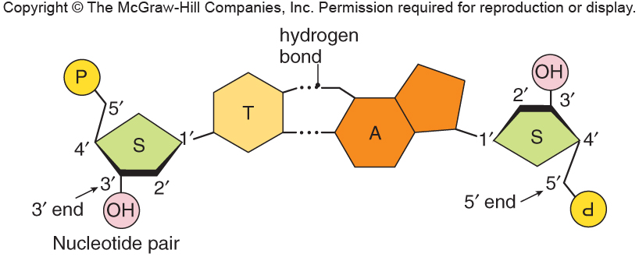
Fig. 11.5a
A and T form 2 Hydrogen bonds. Recall this non-covalent bond type

Slide 8
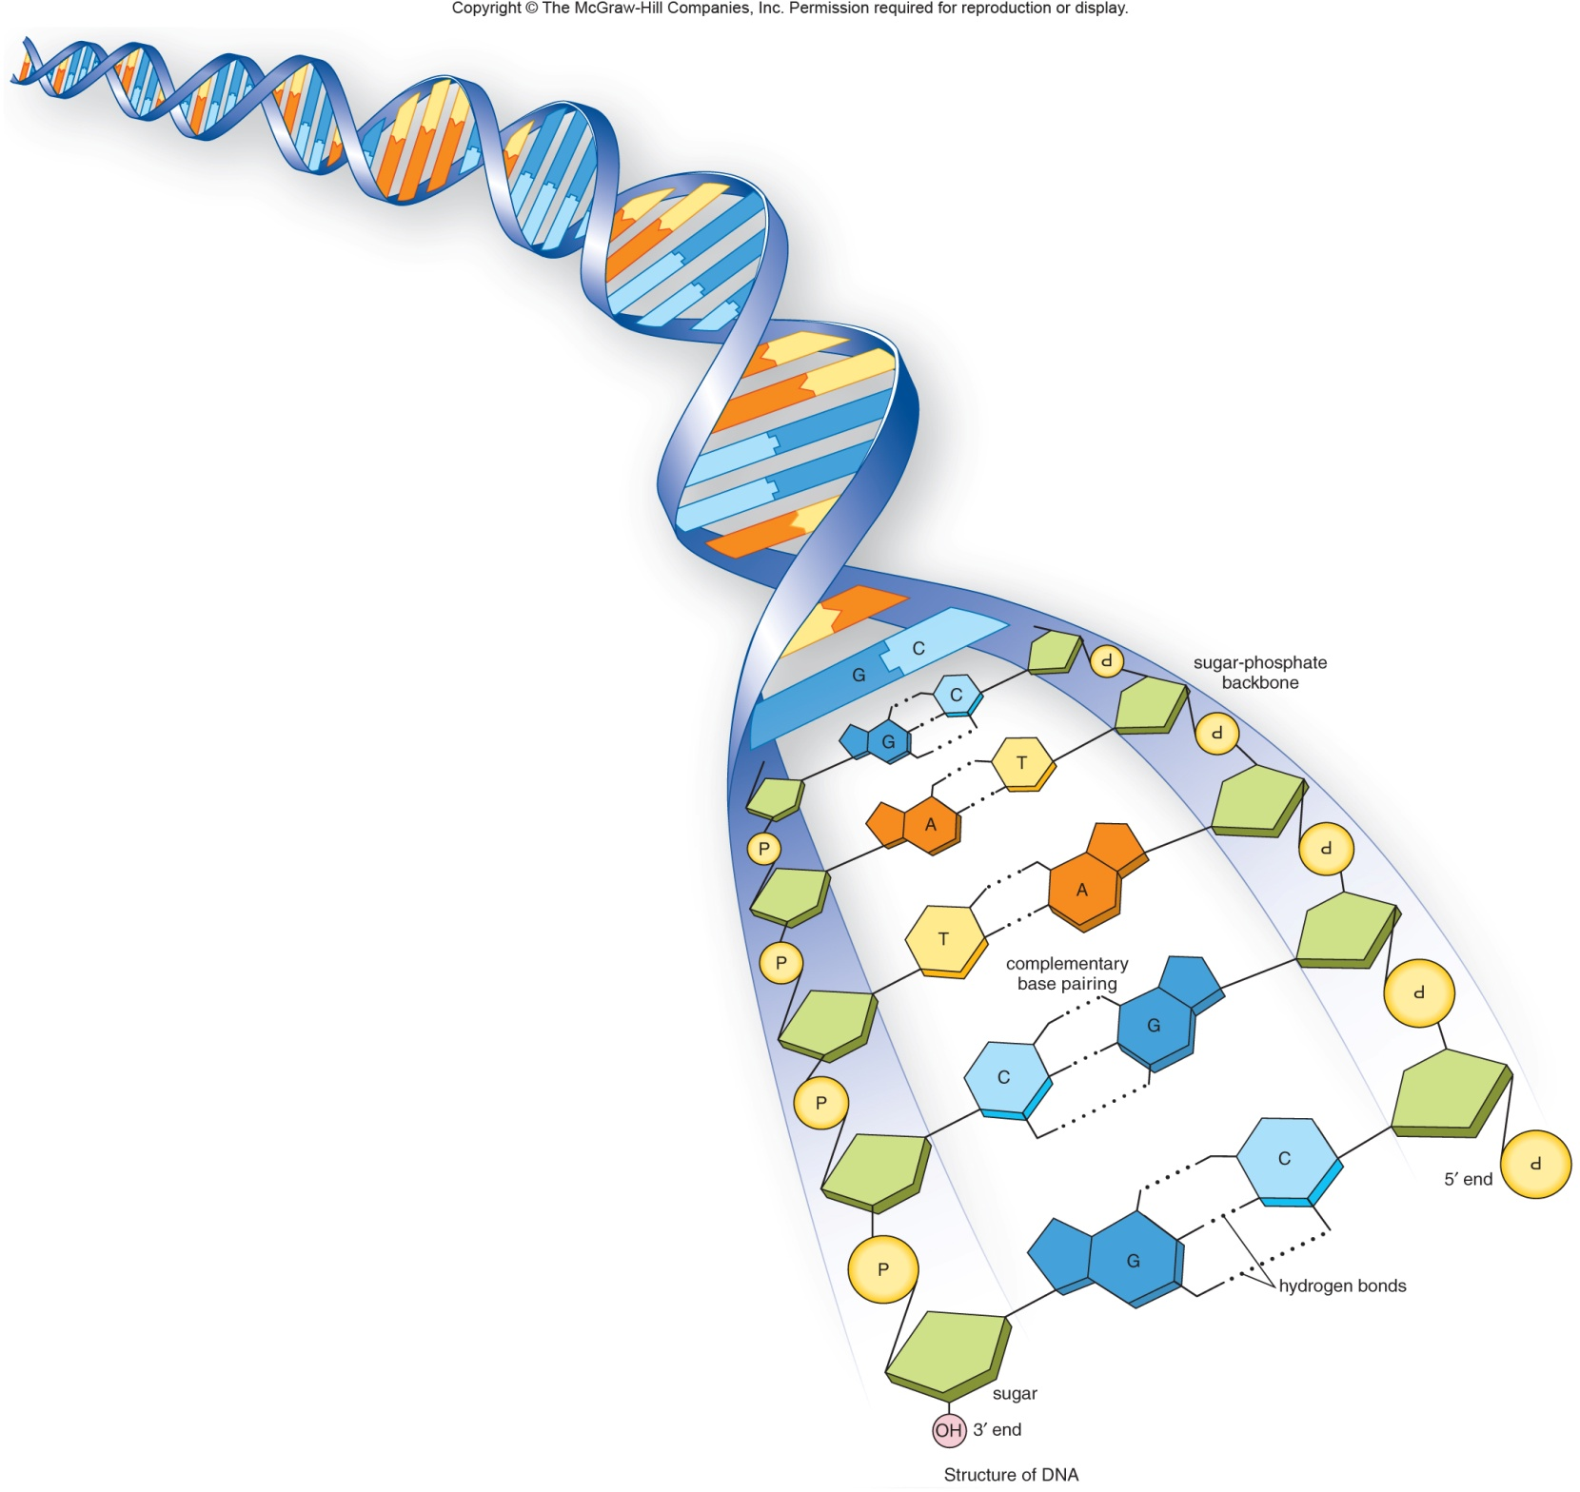
Fig. 11.5b
G and C form 3 Hydrogen bonds. G-C base pairs are stronger than A-T base pairs.

Slide 9
This complementarity----gave W and C a good idea of how the molecule might copy itself.
Other scientists supported the idea with experiments. One key set of experiments were done by 2 scientists---Messelson and Stahl.

Slide 10
Semi-conservative replication
The complementary base-pairing structure of DNA suggested to W and C that each strand was really a “mirror image” of the other. (not an exact copy, but one that reflected the other).
Experiments showed that duplication of DNA used a template mechanism.

Slide 11
Each strand of a DNA molecule can act as a template to copy a second strand. The new molecule has the same overall nucleotide sequence, but will be made of one old strand and one new strand.
The new DNA molecule is half-conserved (semi-conserved)

Slide 12
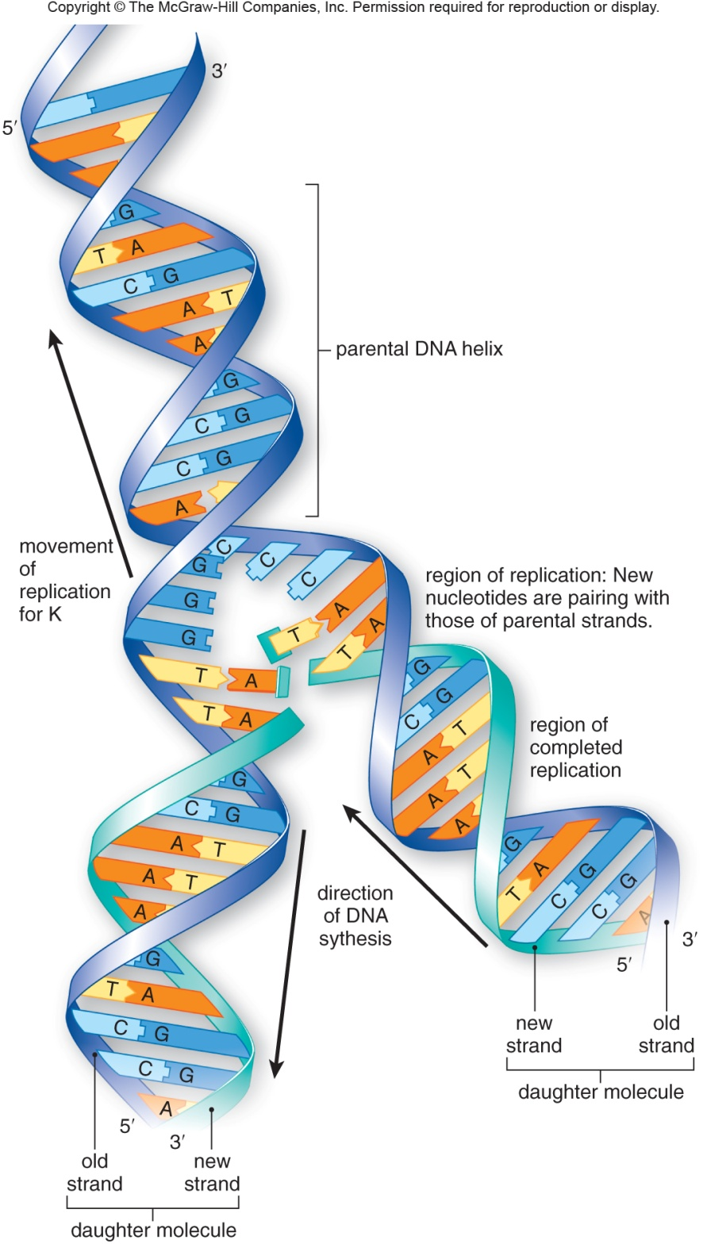
Fig. 11.6

Slide 13
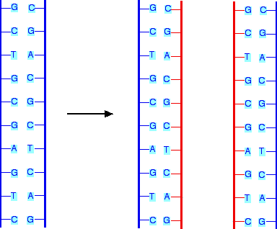
Try this with any sequence of DNA!

Slide 14
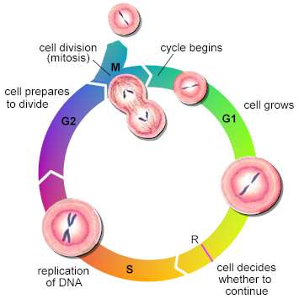
Connecting concepts…
In your cells, where is the DNA?
When is DNA copied?
Why is DNA copied?

Slide 15
We’ve addressed some questions…
If DNA is the the genetic material----how does it work? What does it look like? Is it durable? How is it copied? How does it code for information? How might it change gradually?

Slide 16
More work on DNA…
How does it code for information? What kind of information does it code for?
These are the topics of gene expression (extracting the information stored in DNA)

Slide 17
Gene expression—part 1
Gene expression is really a 2-part process.
1. DNA is changed into a similar molecule called RNA in a process called transcription.
3 types of RNA can be transcribed from DNA. They are known as:
mRNA—the message for the protein encoded in the DNA.
tRNA---an adaptor molecule that helps to decode the mRNA.
rRNA—RNA that is a structural component of the ribosome.

Slide 18
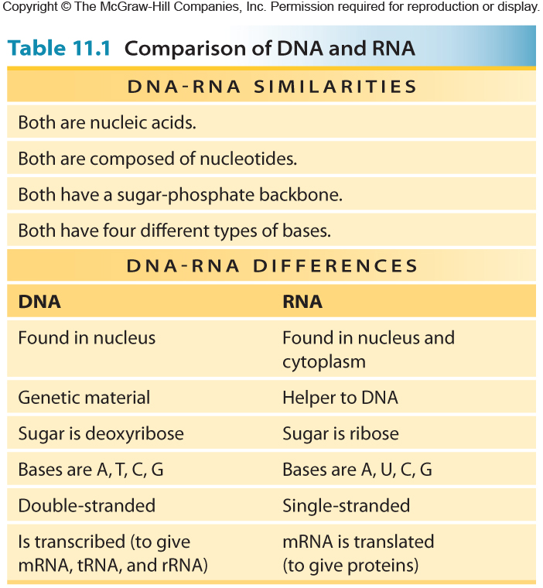
Table 11.1

Slide 19
The RNA produced is the complementary sequence to one of the DNA strands.
The DNA and the RNA then, have virtually the same sequence, but are made from slightly different chemicals.

Slide 20
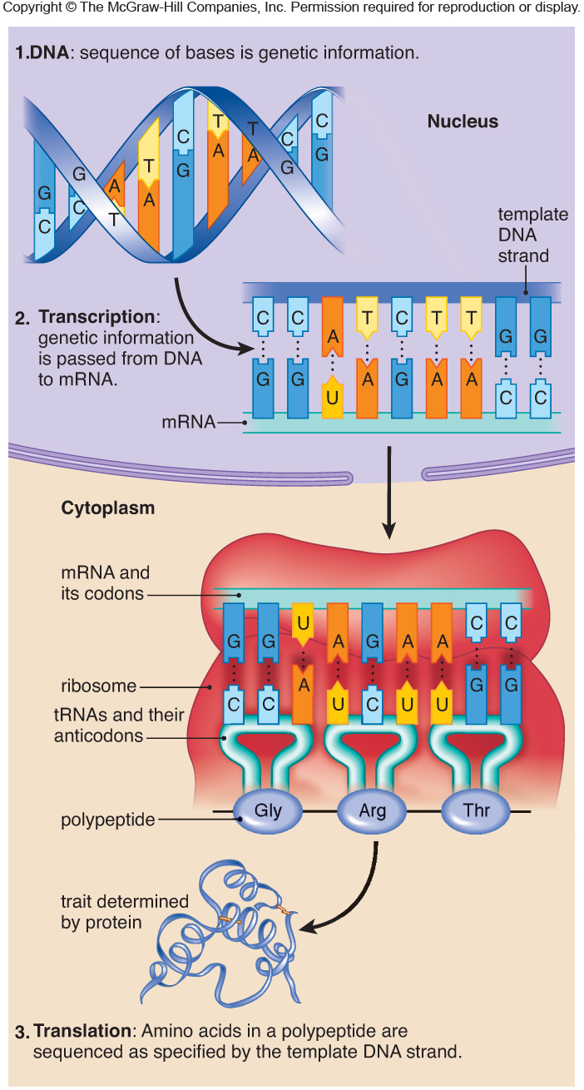
Fig. 11.9

Slide 21
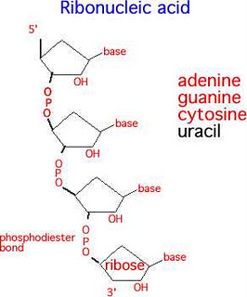

Slide 22
Try to decode this DNA to mRNA
T A C A G C G A A G T T C T T C G T C G T T G T A T T

Slide 23
Gene expression—part 2
Gene expression is really a 2-part process.
2. The mRNA produced in transcription is translated into a protein.
Translation requires the other types of RNA (tRNA and rRNA, and takes place within the ribosomes)
Work in the 1950s-1980s clarified how translation works.

Slide 24
First, lets review what proteins are made of…
Amino acids! There are 20 naturally occurring amino acids---but amino acids are nothing like RNA. How can a sequence of RNA code for a sequence of amino acids?

Slide 25
Cells use a system of 3-nucleotides for each amino acid.
This is called the genetic code. It is referred to as a triplet code.
Each 30 nucleotide code is called a codon.

Slide 26
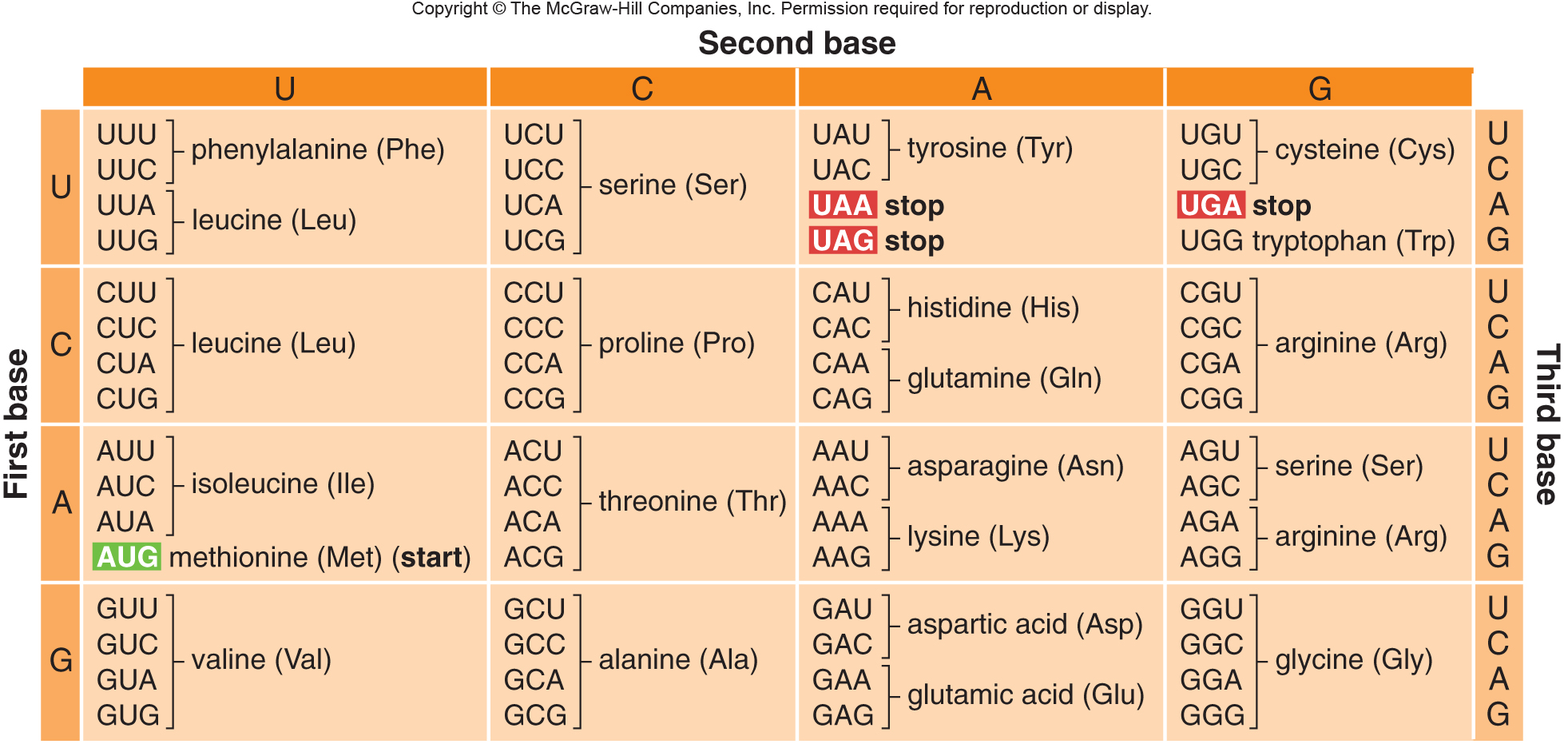
The universal genetic code

Slide 27
20 Amino acids
You don’t have to memorize---but do pay attention to at least some of the names and note the 3-letter abbreviations.

Slide 28
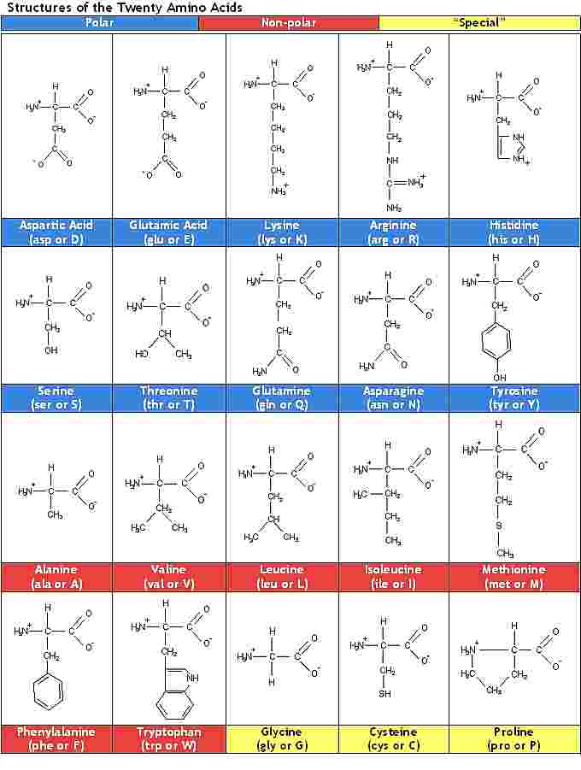

Slide 29
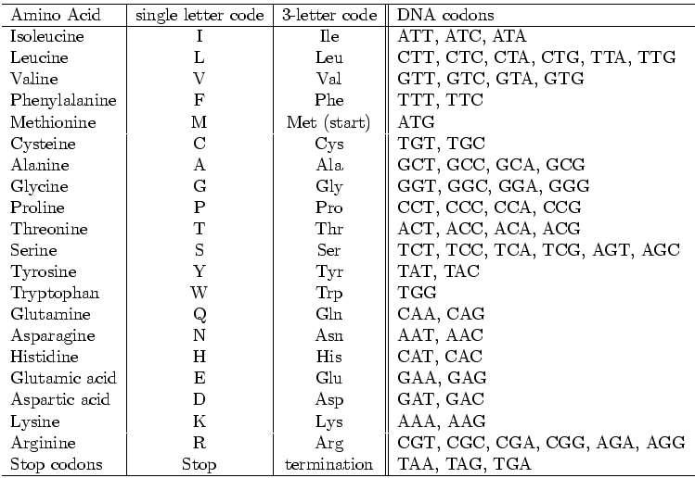

Slide 30
Note that the mRNA can be longer than is needed for the protein produced. Protein synthesis always begins at a specific codon, however.
The codon (AUG) is called the start codon. It codes for the amino acid, methionine.

Slide 31
Likewise, within the mRNA is a particular codon that signals the end of the protein has been reached.
We call this the stop codon. There are 3 different stop codons, UAA, UAG, UGA.
The stop codons don’t code for any amino acids but simply mark where translation should stop.

Slide 32
Find the start and stop codons in this mRNA sequence
CACUUUCACGGGCUAUGUCGCUUCAAGAAGCAGCAACAUAACCGGGCAGGAGCU

Slide 33
CACUUUCACGGGCUAUGUCGCUUCAAGAAGCAGCAACAUAACCGGGCAGGAGCU

Slide 34
Now let’s decode or translate the mRNA you transcribed earlier!
AUG/UCG/CUU/CAA/GAA/GCA/GCA/ACA/UAA
met- ser- leu- gln- glu- ala- ala- thr
24 nucleotides in the mRNA reading frame=8 amino acids in the protein. A small protein (like the one shown) is also called a peptide.

Slide 35
Why “universal”?
The genetic code is known as universal because the same code is used by all organisms to make proteins.
Viruses
Monkeys
Jellyfish
Bacteria
You name it!!

Slide 36
Where do the helper RNAs come into play?
rRNA makes up part of the ribosome
tRNA delivers the amino acids according to the mRNA code

Slide 37
Fig. 11.9
tRNAs have an RNA sequence that is complementary to each codon. They also have a specific amino acid attached to them.

Slide 38
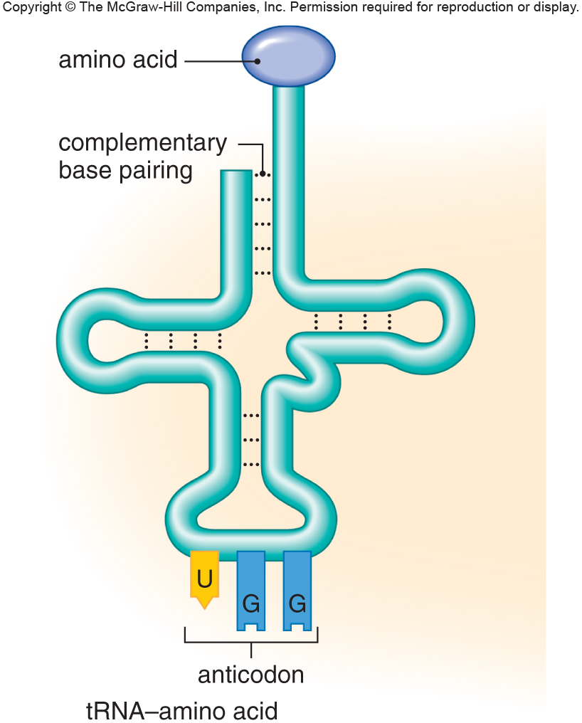
Fig. 11.13a

Slide 39
We won’t focus on more details of transcription and translation…please read and look at figures.
There are minor differences in prokaryotes and eukaryotes.

Slide 40
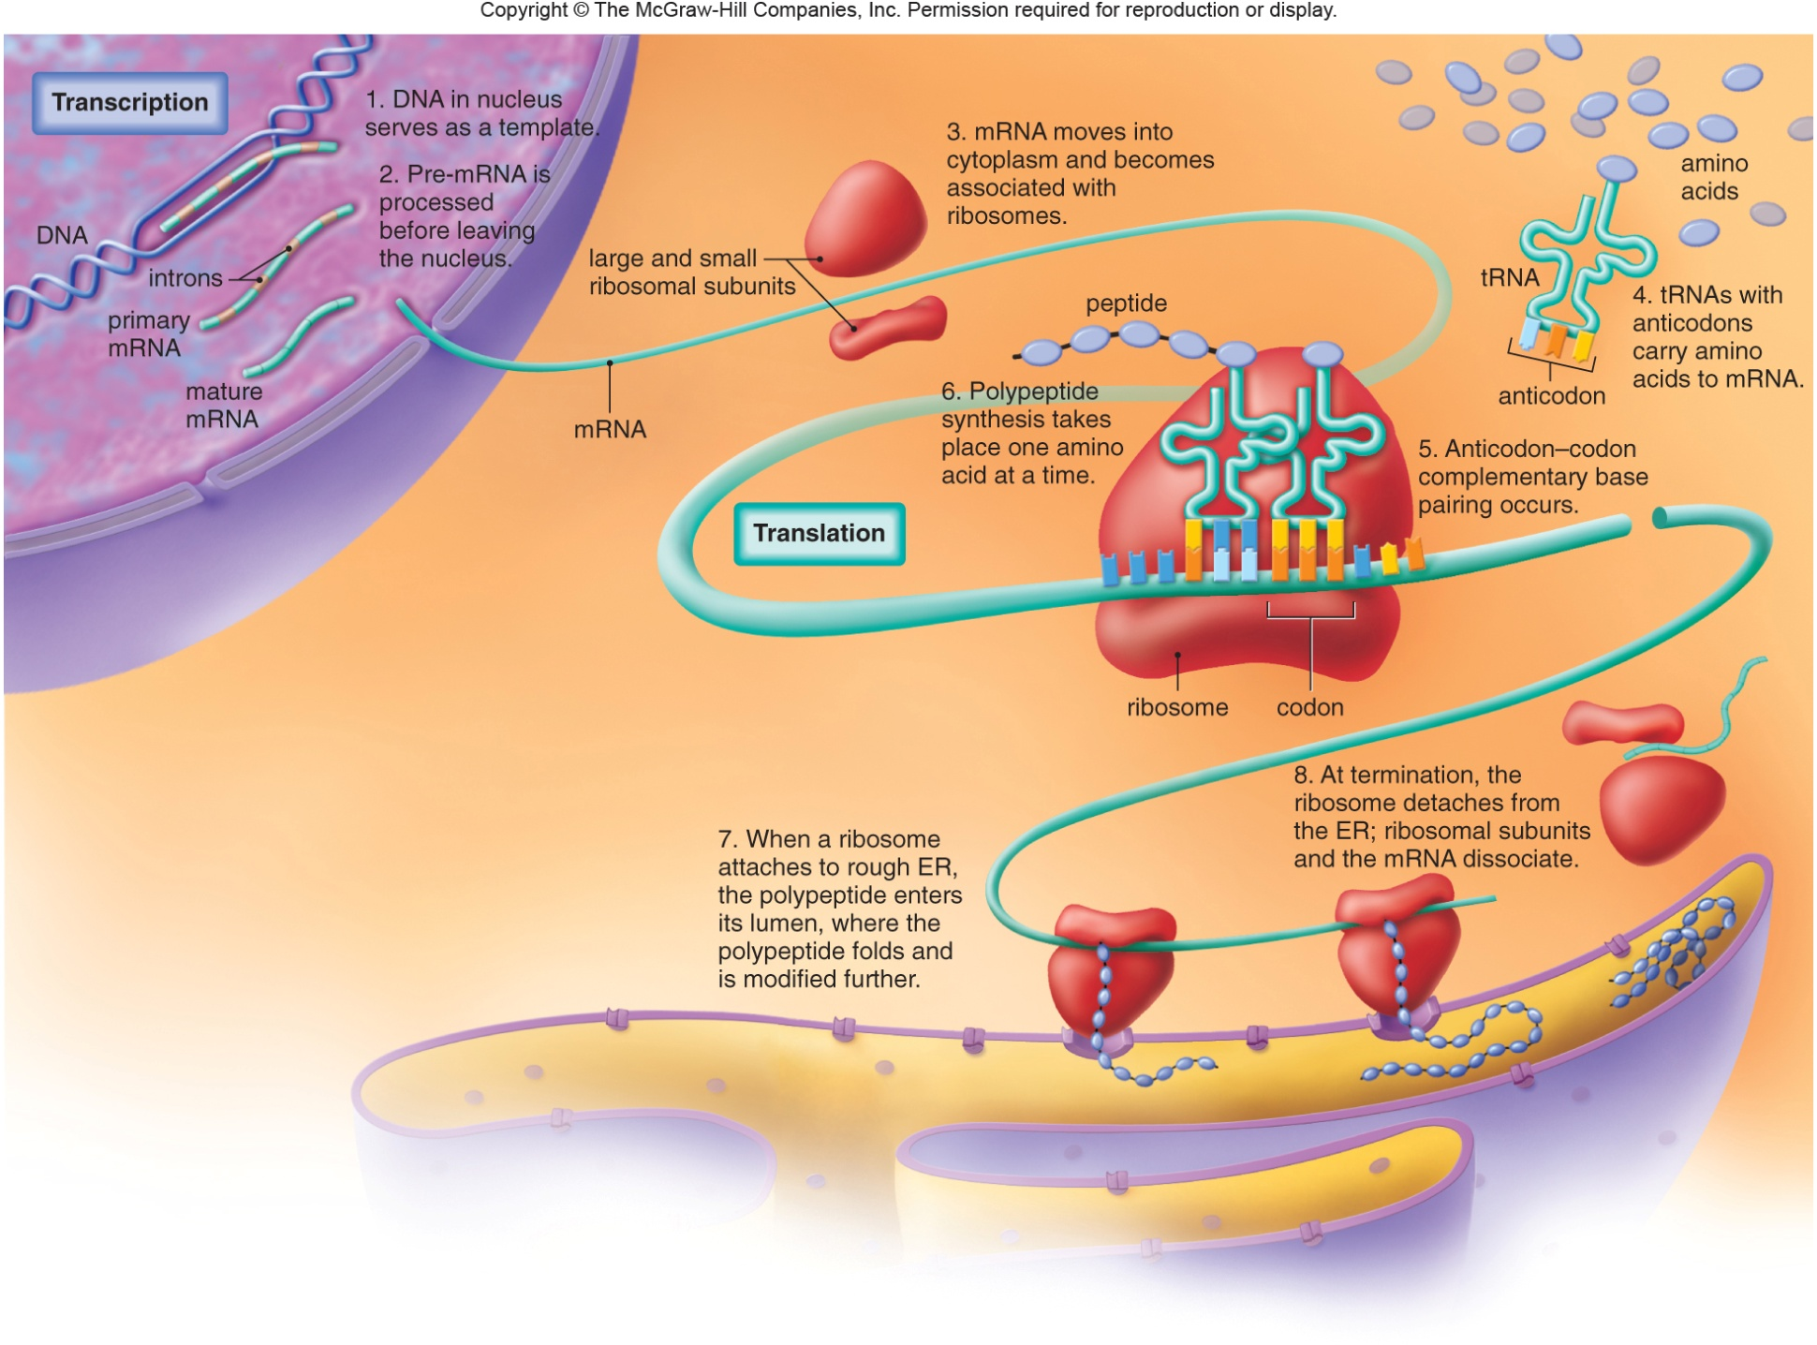
Fig. 11.17

